Slide 1
OpenGl:
Open Graphics Library

Slide 2
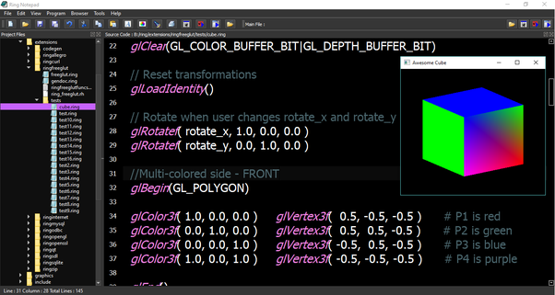
What is opengl?
Open Graphics Library (OpenGL) is a cross-language, cross-platform application programming interface (API) for rendering 2D and 3D vector graphics. The API is typically used to interact with a graphics processing unit (GPU), to achieve hardware-accelerated rendering.
In other words, on the most fundamental level, OpenGL is a software interface that allows a programmer to communicate with graphics hardware.

Slide 3
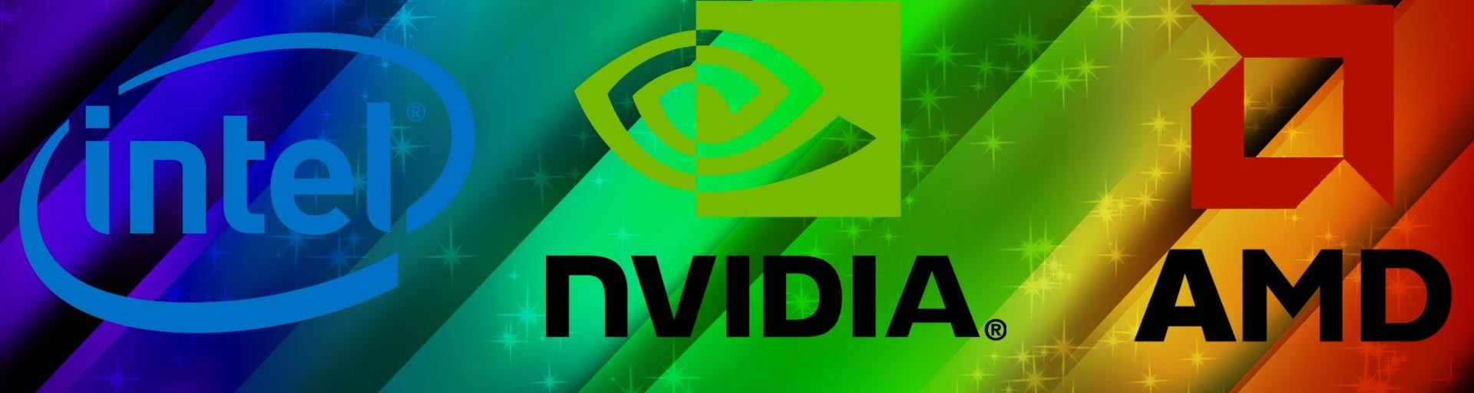
Opengl implementations
Since SGI(Silicon Graphics , the company that created OpenGl) did not provide any actual source-code, but merely a specification of how the API should work. An abstraction presented itself that allowed hardware and software vendors great freedom on how they chose to implement OpenGL. Their implementations , called “drivers”, translate OpenGl api commands into GPU commands.The most important implementations are: Nvidia OpenGl (Nvidia driver), AMD OpenGl(amd driver) and Mesa3d(driver for intel hd graphics).

Slide 4
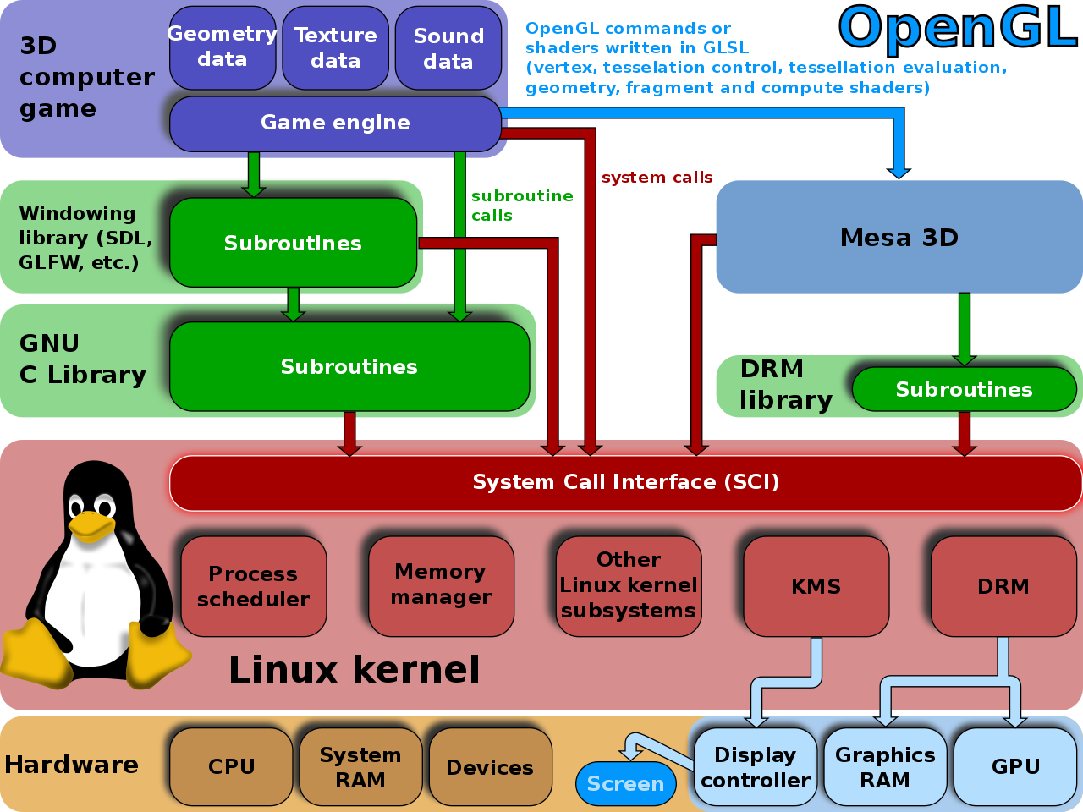
how does opengl work?
OpenGL's job is to receive primitives such as points, lines and polygons, and convert them into pixels (rasterizing). This is accomplished through a graphical pipeline known as the OpenGL state machine. Most OpenGL commands provide primitives to the graphical pipeline or instruct the pipeline on how to process them. Before the introduction of OpenGL 2.0, each stage of the pipeline had a fixed function and was configurable only within certain limits, but since version 2.0 many stages are fully programmable through the GLSL language.
OpenGL is a procedural API that operates at a low level, which requires the programmer the precise steps to draw a scene. This approach contrasts with the high-level descriptive APIs which, operating on a tree structure (scene graph), require the programmer only a generic description of the scene, dealing with the more complex details of the rendering.
So OpenGL does two basic tasks:
1)hide the complexity of interfacing with different 3D accelerators,
offering the programmer a unique and uniform API;
2)hide the capabilities offered by the different 3D accelerators,
requiring that all implementations fully support the OpenGL function set,
resorting to software emulation if necessary.

Slide 5
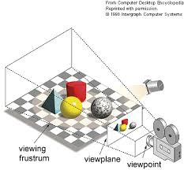
REndering
Rendering or image synthesis is the automatic process of generating a photorealistic or non-photorealistic image from a 2D or 3D model (or models in what collectively could be called a scene file) by means of computer programs. Also, the results of displaying such a model can be called a render. A scene file contains objects in a strictly defined language or data structure; it would contain geometry, viewpoint, texture, lighting, and shading information as a description of the virtual scene. The data contained in the scene file is then passed to a rendering program to be processed and output to a digital image or raster graphics image file. The term "rendering" may be by analogy with an "artist's rendering" of a scene.

Slide 6
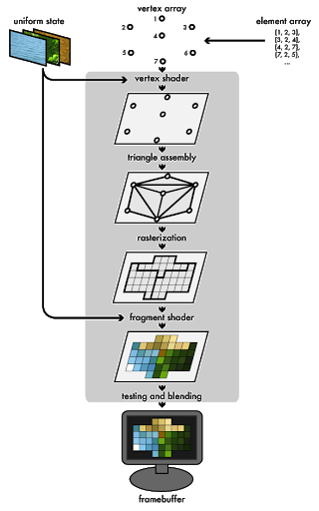
OpenGl rendering pipeline
The Rendering Pipeline is the sequence of steps that OpenGL takes when rendering objects. The OpenGL rendering pipeline is initiated when you perform a rendering operation. Rendering operations require the presence of a properly-defined vertex array object and a linked Program Object or Program Pipeline Object which provides the shaders for the programmable pipeline stages. Once initiated, the pipeline operates in the following order:

Slide 7
Shader(innovano il pipeline) dopo!
In the year 2000, Microsoft released Direct3D 8.0, which supported a new feature called shaders. Shaders are basically nothing more than little programs that run directly on the GPU, thus leveraging even more of the GPU's power and moving more functionality away from the CPU. A vertex shader is a GPU program that is executed once per vertex that is assigned to, and a pixel shader is a GPU program that is executed once per pixel. In 2003 Microsoft released Direct3D 9.0, that allowed the manipulation of shaders in a high-level language whose syntax was based on C. Shading languages are used to program the GPU's rendering pipeline, which has mostly superseded the fixed-function pipeline of the past that only allowed for common geometry transforming and pixel-shading functions; with shaders, customized effects can be used.

Slide 8
sHADERs’ type

Slide 9
OpenGl:uses

Slide 10
Opengl: history and versions

Slide 11
Opengl: libraries

Slide 12
Opengl:mathematical basis

Slide 13
Opengl for andoird: opengl es

